Slide 1


Mānoa Faculty Senate
2012 Elections

Slide 2
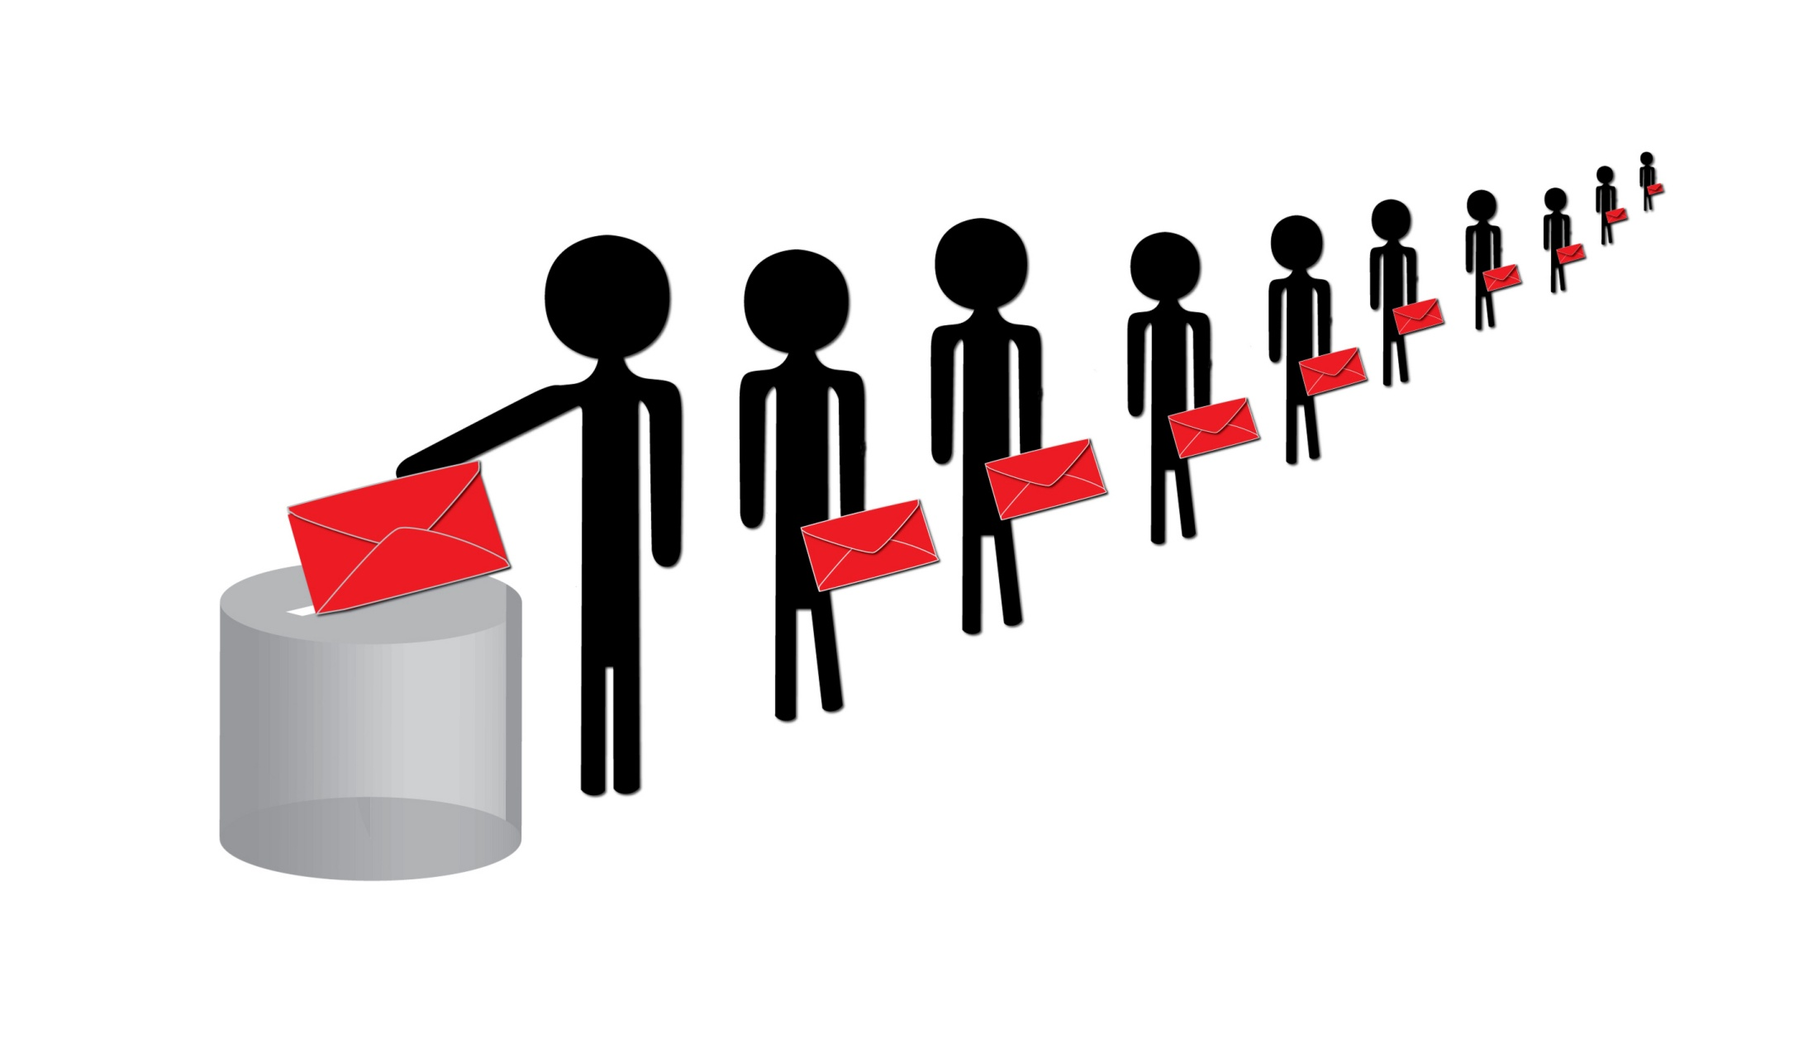
Voter Turnout
33%

Slide 3

Aurelio Agcaoili
Kimberly Binsted
David Chin
Xu Di
R Ertekin
Miguel Felipe
Jennifer Herring
Julie Iezzi
Judith Inazu
Ken Ito
Thao Le
Gabor Mocz
Martin Oishi
Robert Paull
Martin Rayner
Scott Robinson
Maya Saffery
David Sanders
Gwen Sinclair
Anna Stirr
James Caron
William Chain
Williamson Chang
Robert Cowie
Timothy Dye
Mark Levin
Jennifer Matsuda
Torben Nielsen
Carol Plummer
Stacey Roberts
Janice Shoultz
Halina Zaleski

Slide 4

Senate Executive Committee

Slide 5

NAME-constituents@lists.hawaii.edu

Slide 6

Thank
You
for your
Service!

